Slide 1
Reaction kinetics
8.1 Rate of reaction
8.2 Effect of temperature on reaction rates and the concept of activation energy
8.3 Homogeneous and heterogeneous catalysts

Slide 2
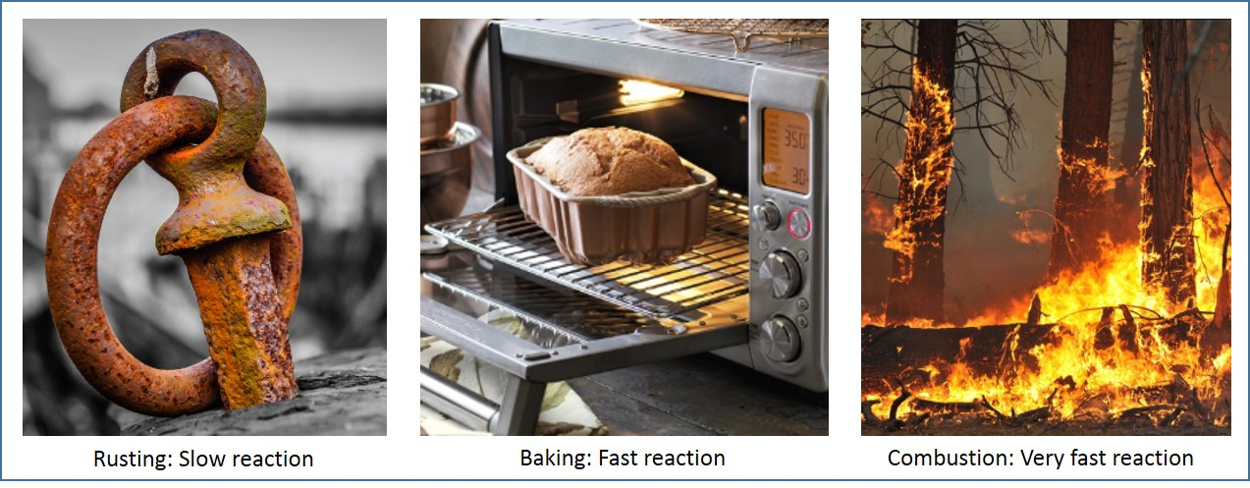
Introduction
Reaction rate is defined as the speed at which a chemical reaction proceeds.
Rusting of iron is a chemical process that happens over the years.
Baking and combustion are chemical reactions that happen in fast phase.
Reaction rate

Slide 3
Simple collision theory
Collision theory is used to analyse the rate of the reaction with respect to various parameters such as pressure and concentration in terms of collisions between the particles that are reacting.
For a collision to be successful, two particles must collide with each other in proper orientation and sufficient energy.
If the reacting particles do not possess sufficient energy, then the collision is unsuccessful.
The minimum energy required by the reacting particles for a successful collision to take place is called as activation energy.

Slide 4
Simple collision theory
With increase in pressure or concentration, the number of collisions in a specific time increases. In other words, the frequency of collisions increases.
The number of successful collisions also increases with the temperature because when temperature increases, the speed of particles increases, which in turn increases their energy and hence, the frequency of collisions.

Slide 5
Rate of a reaction
Rate of a reaction is the change in concentration of a substance in unit time. Its unit is mol/dm³s.
Rate of the reaction over a time period can be calculated by finding the gradient of curve in concentration-time graph.
To find rate of a reaction at a particular point of time, the gradient of tangent of curve at that particular time is taken.
The initial rate is the rate at the starting point (t=0), which is the fastest.

Slide 6
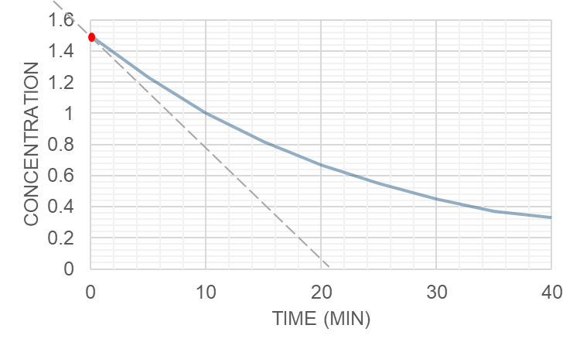
Rate of reaction
Example 1: Find the rate of reaction for this concentration of reactant versus time graph.
  At t=0
  For the first 5 minutes
  At 10 minutes
Solution:
At t=0, the rate of reaction is the slope of the tangent of the curve at that point,
$$rate of reaction=\frac{1.5−0}{20×60}=1.25×{10}^{−3} mol/{dm}^{3}s$$
Concentration of reaction-time

Slide 7
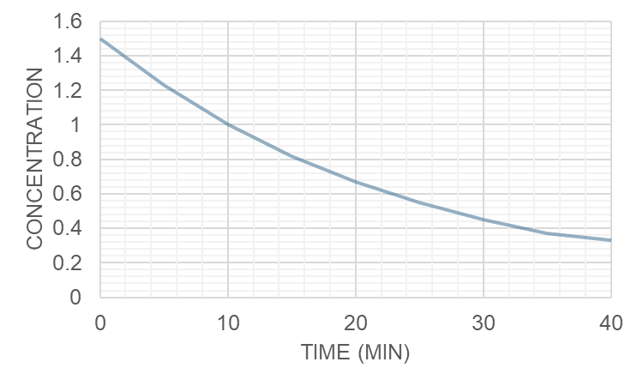
Rate of reaction
Example 1: Find the rate of reaction for this concentration of reactant versus time graph.
  At t=0
  For the first 5 minutes
  At 10 minutes
Solution:
Rate of reaction for the first 5 minutes is,
$$\frac{change in concentration}{time}=\frac{1.5−1.2}{5×60}=0.001mol/{dm}^{3}s$$
Concentration of reaction-time

Slide 8
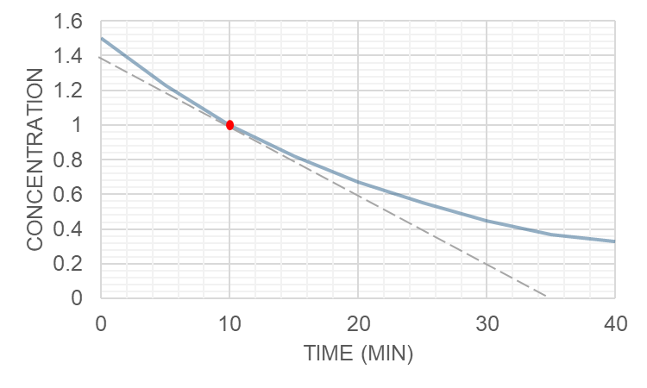
Rate of reaction
Example 1: Find the rate of reaction for this concentration of reactant versus time graph.
  At t=0
  For the first 5 minutes
  At 10 minutes
Solution:
At t=10 min, the rate of reaction is the slope of the tangent of the curve at that point,
$$rate of reaction=\frac{1.4−0}{33×60}=7.07×{10}^{−4} mol/{dm}^{3}s$$
Concentration of reaction-time

Slide 9
Techniques to investigate the rate of reaction
To calculate the rate of reaction, either the amount of disappearance of reactant or the amount of appearance of product must be measured. There are two methods to measure these:
Sampling: Small samples of reaction mixture are taken at various times and analysed.
Continuous: The physical property is measured over a range of time period using different methods.

Slide 10
Techniques to investigate the rate of reaction: Sampling
        Small samples of reaction mixture are taken at various times and analysed. Consider this reaction of bromobutane:
    C₄H₉Br + OH⁻ →C₄H₉OH + Br⁻
    The concentration of hydroxide ions at various times can be found by titration.

Slide 11
Techniques to investigate the rate of reaction: Continuous
Colorimetry
Colour of a particular reactant or product is noted throughout the time period. For example:
H₂O₂(aq) + 2I⁻ (aq) +2H⁺ (aq) → 2H₂O(l) +I₂ (aq)
The iodine solution produced is brown in colour. As the reaction proceeds, the intensity of brown colour increases. The intensity of colour is measured using colourimeter.

Slide 12
Techniques to investigate the rate of reaction: Continuous
Changes in electrical conductivity
Electrical conductivity of a reaction mixture varies with the number of ions.
For example: As the following reaction proceeds, the conductivity of the solution increases due to production of ions.
(CH₃)₃CBr + H₂O → (CH₃)₃COH + H⁺ +Br⁻
This method can be used even when ions are present in both the reactants and products. H+ and OH- ions have high conductivities but ions such as Br- have low electrical conductivities. Hence, measure of electrical conductivities indirectly tells us about the concentration of reactants or products.

Slide 13
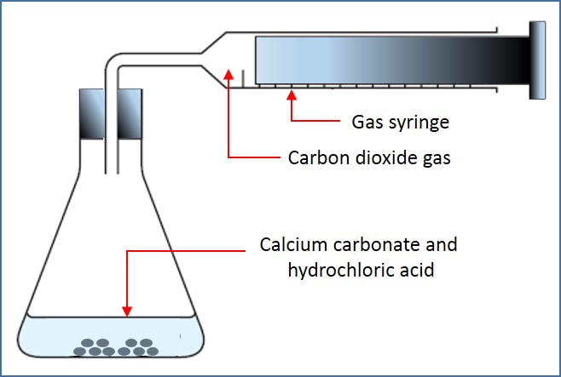
Techniques to investigate the rate of reaction
Changes in gas pressure or volume
In reactions wherein one of the products is in gaseous state, this method can be used. The volume of product in gaseous state can be measured using the marking in the syringe.
For example: When calcium carbonate reacts with hydrochloric acid, carbon dioxide gas is released. The volume of CO₂ can be measured using this experimental setup.
CaCO₃(s)+2HCl(aq)→CaCl₂(aq)+CO₂(g)+H₂O(l)
Investigating the rate of reaction

Slide 14
Techniques to investigate the rate of reaction
Change in mass
Measurement in change of mass helps in the calculation of rate of reaction in case gases formed in a reaction are allowed to escape. This method highly suitable in case the gases are heavy. For example: carbon dioxide.
Small changes in volume
Rate of reaction can also be calculated by measuring the change in volume. For example: during hydration of methylpropene, the volume decreases. An instrument called dilatometer is used to measure small changes in volume.
$${(CH_{3})}_{2}C=CH_{2}+H_{2}O\underset{→}{H^{+}}{(CH_{3})}_{3}COH$$

Slide 15
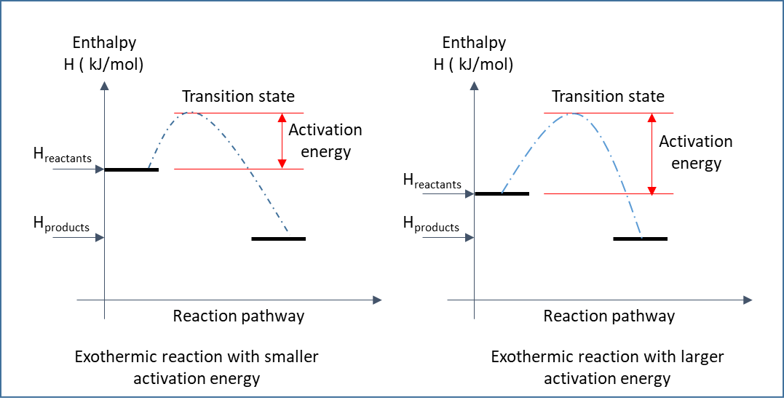
Activation energy
The minimum energy required by the reacting particles for a successful collision to take place is called as activation energy.
The reaction profile of exothermic reactions with small and large activation energies are given in the figure.

Slide 16
Activation energy: Exothermic
Exothermic reactions with smaller activation energy takes places slowly at room temperature.
This is because only fewer particles have energies greater than activation energy.
The particles at the peak of the curve are said to be in transition state. This represents some bonds that are either made or in the process of being broken.

Slide 17
Activation energy: Exothermic
Exothermic reactions with larger activation energy takes places rapidly at room temperature.
This is because only more particles have energies greater than activation energy resulting in higher successful collisions.

Slide 18
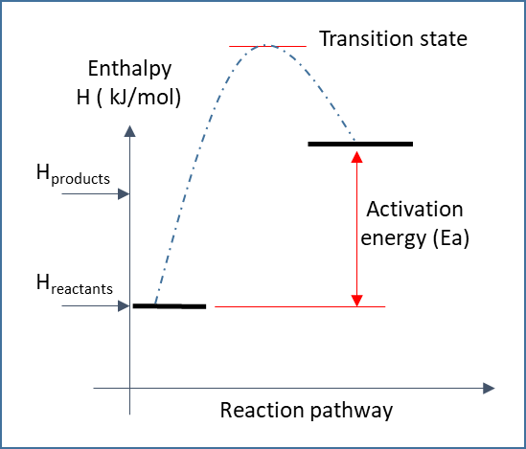
Activation energy: Endothermic
The reaction profile of endothermic reactions with activation energy Ea is given.

Slide 19
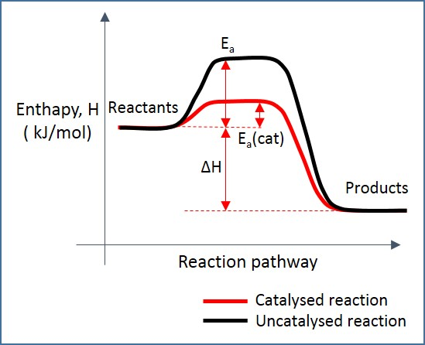
Catalysts
Catalyst is a chemical substance that increases the rate of reaction and remains chemically unchanged till the end of reaction.
Catalyst increases the rate of reaction by choosing an alternate route for the reaction which has a lower activation energy.
The effect of a catalyst

Slide 20
Catalysts
Homogenous
A catalyst is said to be homogenous if it is in the same phase of that of reactants.
For example, reactants are in aqueous form and the catalyst is also dissolved in water.
Otherwise, all reactants and catalyst are in gaseous state. Example: Destruction of atmospheric ozone in the presence of ultraviolet radiation. The catalyst is chlorine radical.
Heterogenous
A catalyst is said to be heterogenous when it is in a phase which is different from that of reactants.
For example: Decomposition of hydrogen peroxide solution gives oxygen gas. This reaction is fastened by adding insoluble solid manganese (IV) oxide. This reaction takes place in the surface of heterogeneous catalysts.

Slide 21
Catalysts
Catalyst lower the temperature and pressure constraints on a reaction.
With the use of catalyst, a reaction can be successful at a much lower temperature and pressure. This saves cost of production in industries.
The burning of fossil fuels is reduced thus fewer carbon dioxide emissions.
Catalyst remains unused and hence, can be reused. It also improves the atom economy by minimising the number of waste products.

Slide 22
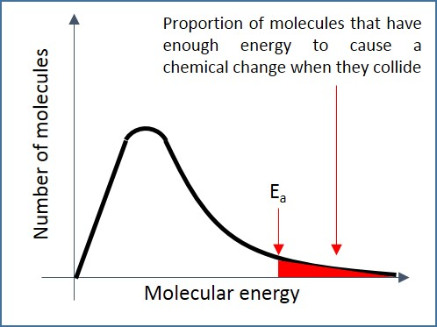
Boltzmann distribution
In a sample of reaction mixture, all the particles do not possess the same amount of energy.
Some particles have relatively high energy and some relatively low.
Most of the particles have medium levels of energy.
The energy distribution at a given temperature with respect to number of molecules is shown in figure. This is called as Boltzmann distribution.
Boltzmann distribution

Slide 23
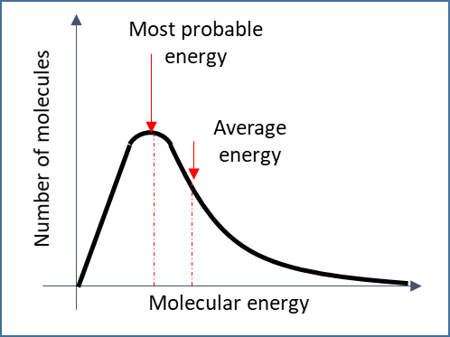
Boltzmann distribution
No particles have zero energy. Even though most particles have intermediate energies, a few particles have higher energies.
There is no limit to the molecular energy. The most probable energy is different from average energy.
The molecules with energies greater than activation energy (E_{a}) are responsible for the initial successful collisions.
The shaded area shows the number of molecules with energies greater than activation energy.
Boltzmann distribution

Slide 24
Boltzmann distribution
The molecules with energies greater than activation energy (E_{a}) are responsible for the initial successful collisions.
The shaded area shows the number of molecules with energies greater than activation energy.
The total area under the curve denotes the total number of particles.
Boltzmann distribution

Slide 25
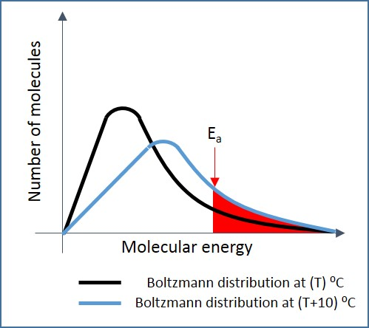
Effect of temperature on rate of reaction
When temperature increases, the average kinetic energy of the molecules increases, resulting in more frequent collisions.
The graph of increased temperature ((T+10) ⁰C) shifts to right, resulting in increase of proportion of molecules with energies greater than the activation energy.
Hence, with increase in temperature, more successful collisions take place and the rate of reaction increases.
Effect of temperature change on Boltzmann distribution

Slide 26
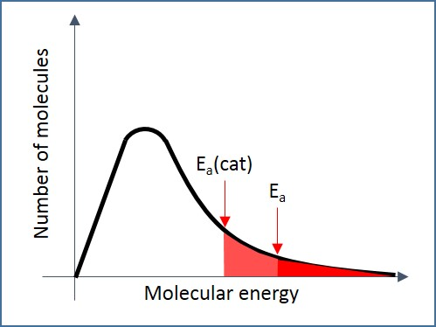
Effect of catalysts on rate of reaction
Catalysis increases the rate of reaction by lowering the activation energy.
The Boltzmann distribution in the presence of catalyst is shown in figure.
The shape of the curve remains the same.
The activation energy drops due to the presence of catalysts.
This increases the proportion of molecules with energies greater than activation energy.
Therefore, in the presence of catalysts more successful collisions takes place resulting in increase of rate of reaction.
Effect of catalyst on Boltzmann distribution

Slide 27
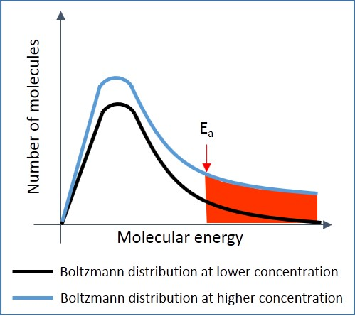
Effect of change in concentration and pressure on rate of reaction
When pressure or concentration increases, the average number of molecules per unit volume increases, resulting in more frequent collisions.
The Boltzmann distribution for a greater concentration is shown in figure.
The graph of increased concentration has the same shape, and the peak is at the same energy level. The most probable energy or the mean energy does not change.
It can be noted that the curve is higher now and more molecules have energy greater than the activation energy.
Hence, with increase in concentration, more successful collisions take place and the rate of reaction increases.
Effect of concentration on Boltzmann distribution

Slide 28
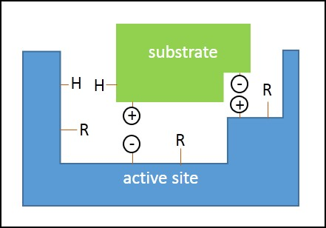
Enzymes
A substrate bonded to active site of an enzyme is shown in the figure.
The presence of hydrogen in both active site and substrate denotes that hydrogen bonding is possible. ‘+’ and ‘-’ represents the ionic interactions.
Van der waals’ forces are present between the substrate and R in active site. R groups are the side chain of amino acids.
Bonding between active site and substrate of an enzyme

Slide 29
Enzymes
The enzyme and substrate form a complex and the reaction takes place and products are released from the active site.
In case of substrates with chirality, it is possible that the active site will bind with one type of enantiomer only. This type of active site is called as stereospecific active site. This is because the other enantiomer’s structure and shape are not favourable to form bonds with active site.
Enzymes can be inhibited by drugs. Some drugs designed using computers may bind with the active site of enzyme strongly. Thus, blocking the substrate to bind with enzyme. Some drugs attach to other places of enzymes but may change the shape of the enzyme. Again, the substrate is blocked.

Slide 30
Catalysis
  Catalysts are chemicals that speed up the reaction by lowering the activation energy and remain unchanged at the end of the reaction.
  Homogenous catalysts:
  Catalysts which are in same phase as that of reactants are called as homogenous catalysts. For example: The reaction between iodine and peroxodisulfate.
  S₂O₈²⁻ (aq) + 2I⁻ (aq) →2SO₄²⁻ (aq) + I₂ (aq)
  Both iodine and peroxodisulfate are negatively charged and in order to overcome the force of repulsion during collision these molecules need energy. Fe³⁺ catalyses the reaction between iodine and peroxodisulfate.

Slide 31
Catalysis
  Fe³⁺ catalyses the reaction between iodine and peroxodisulfate. The redox reactions are:
2Fe³⁺ + 2I⁻ (aq) → 2Fe²⁺(aq) + I₂(aq)
2Fe²⁺(aq) + S₂O₈²⁻ (aq) → 2Fe³⁺(aq) + 2SO₄²⁻ (aq)
The peroxodisulphate ions oxidise Fe²⁺ ions to Fe³⁺ ions and in this process peroxodisulphate ions are reduced to sulphate ions.
The Fe³⁺ ions are strong oxidising agents and oxidise iodine ions to iodine. In this reaction, Fe³⁺ ions are reduced back to Fe²⁺ ions.
According to the above reactions, now the reactants are oppositely charged and require a much lower activation energy.

Slide 32
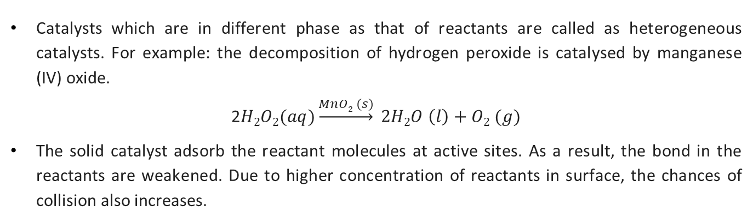
Heterogeneous catalysts
Catalysts which are in different phase as that of reactants are called as heterogeneous catalysts. For example: the decomposition of hydrogen peroxide is catalysed by manganese (IV) oxide.
2$H2O2(aq)\underset{→}{MnO2 (s)} 2H2O \left(l\right)+O2 (g)$
The solid catalyst adsorb the reactant molecules at active sites. As a result, the bond in the reactants are weakened. Due to higher concentration of reactants in surface, the chances of collision also increases.

Slide 33
Heterogeneous catalysts: Contact process
Vanadium pentoxide catalyses the contact process. Contact process is used for the production of sulphuric acid. The overall reaction is,
2SO₂ + O₂ ⇋ 2SO₃
The reactions in the presence of vanadium pentoxide are:
SO₂ + V₂O₅ → SO₃ + V₂O₄
2V₂O₄ + O₂ → 2V₂O₅
  Each of these two steps require a lower activation energy when compared to the uncatalysed single step.

Slide 34
Catalytic converters
  Transition metals are used in catalytic converters to convert the harmful exhaust gases such as carbon monoxide, nitrogen oxides and unburnt hydrocarbons from vehicles to harmless carbon dioxide, nitrogen and water.
  The catalytic converters consists of a honeycomb structure which are coated with metals such platinum, palladium or rhodium.

Slide 35
Catalytic converters
2CO + 2NO→2CO₂ + N₂
  Firstly, the harmful gases are adsorbed onto the active sites of catalyst. The covalent bonds within the reactants are weakened.
  New bonds are formed between adjacent nitrogen atoms. Also, new bonds are formed between carbon monoxide and oxygen to form carbon dioxide.
  The nitrogen molecule and carbon dioxide molecule are released from the surface of the catalyst. This is called as desorption.

Slide 36
Catalysis
Ammonia is synthesised using Haber’s process and the reaction is
N₂ (g) + 3H₂ (g) ⇋ 2NH₃ (g) ΔH_{r}=-92 kJ/mol
In this reaction, iron acts as catalyst. The molecules of hydrogen and nitrogen come closer on the surface of iron. The various steps are:
Diffusion: Hydrogen gas and nitrogen gas diffuse to the surface of iron.
Adsorption: The molecules form chemical bonds with iron, which weaken the covalent bonds within the molecules and allow them to react with each other to form product and leave the catalyst.

Slide 37
Catalysis
Reaction: Chemical reaction between hydrogen and nitrogen results in formation of ammonia.
Desorption: The bonds between ammonia and iron is weakened so that it can be released from the surface of catalyst.
Diffusion: Ammonia diffuses away from catalyst.

